Slide 1


Institute for Advanced Computing and Software Development, Akurdi
Project Review on
e-Farmers Market
Guided By:
Mr.Milind Sir
Project By:
Group 59
Hrushikesh Vitnor (1216)
Ajit Patil(1173)

Slide 2
Introduction
Farming is the Prime Occupation in India in spite of this, today the people involved in farming belongs to the lower class and is in deep poverty.
. Agro-marketing would make all the things automatic which make easier serving as a best solution to all the problems. Farmer’s e-Market will serve as a way for the farmers to sell their products across the country just with some basic knowledge about
how to use the websiteFarmers e-Market is the web application that will help the farmers to perform the agro-marketing leading to achieve success and increase in their standard of living

Slide 3
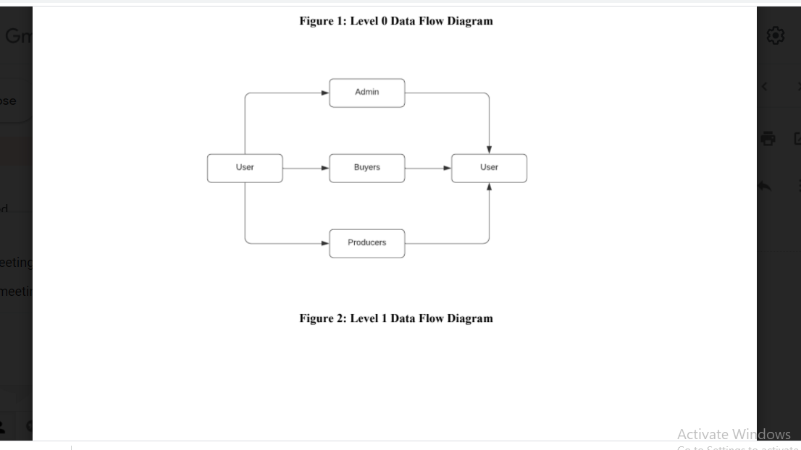
Data flow Diagram

Slide 4
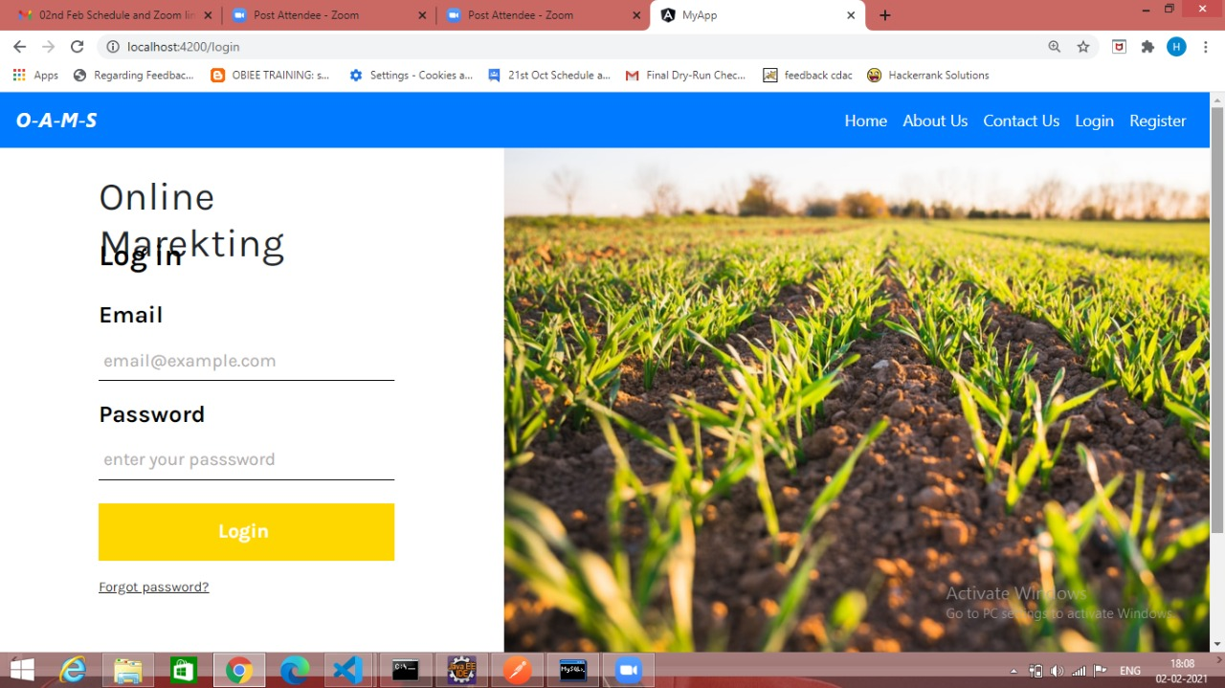
Login Page

Slide 5
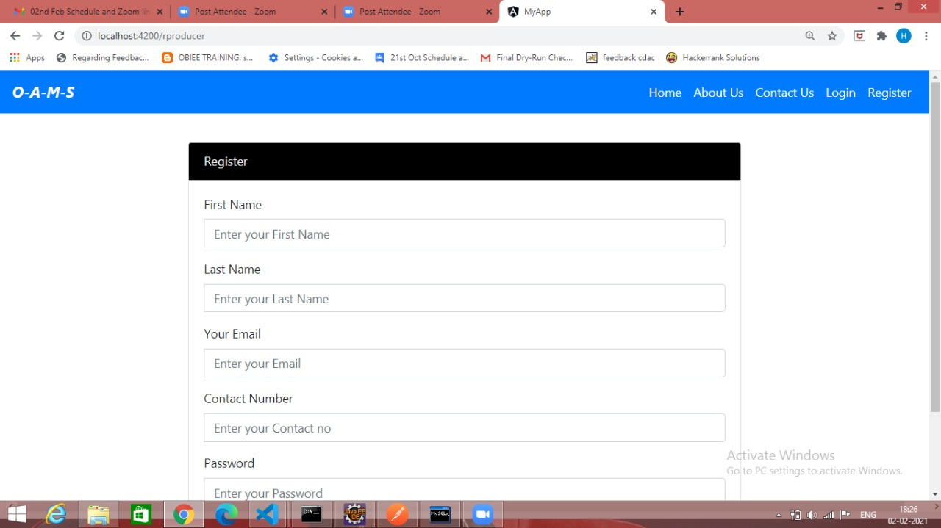
Registration Page

Slide 6
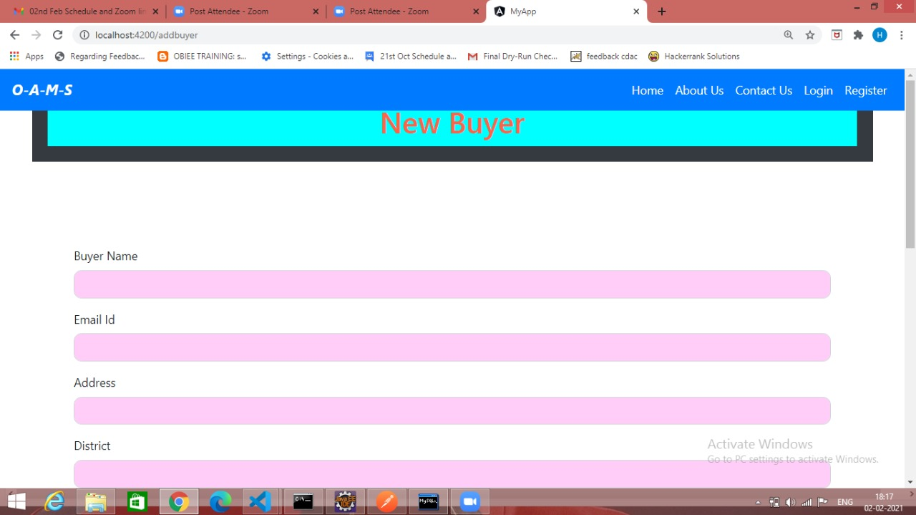
Adding new buyer

Slide 7
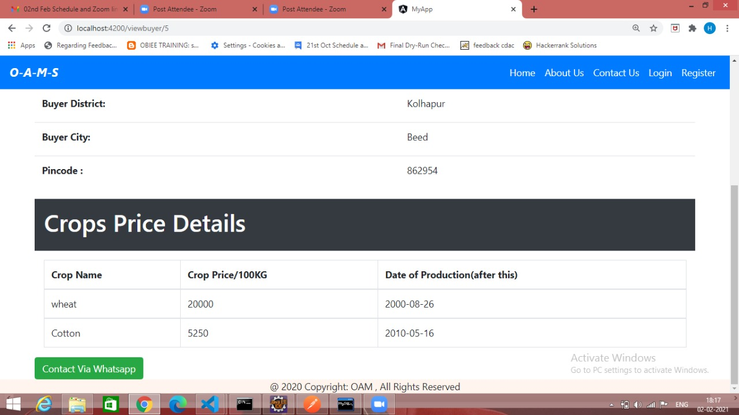
After validation of buyer

Slide 8
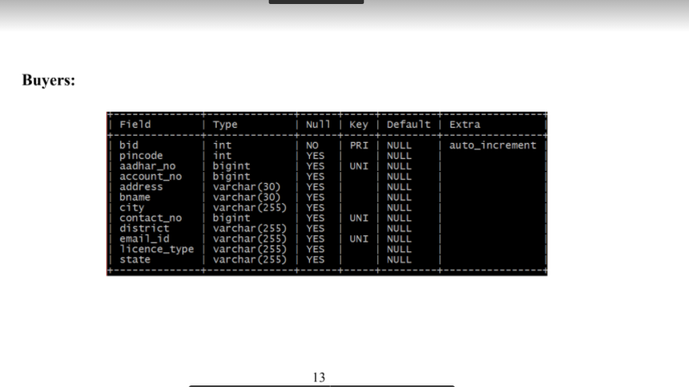
Newly added entries in database

Slide 9
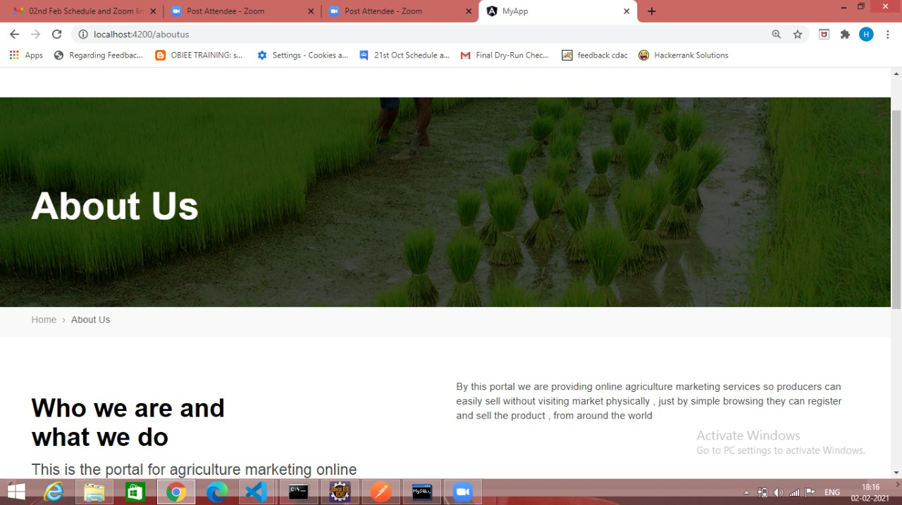
About Us Page

Slide 10
Future Scope
Implementation of Debit/Credit payment modes:In this website we have worked upon implementation of net banking only. Debit and credit will be implemented in future.
Payment Gateway:In this project we have designed false transaction which will show only that transaction is successful,similar to virtual transaction for better understanding.
Partial Payment:Partial payment will help user as well as farmer to buy and sell the product required by user accordingly.

Slide 11
Conclusion and Proposed Scope :
This system has been a way of minimizing the clerical work, which is almost a routine and consumes the most precious time.
The main objectives of the proposed system are:
J2EE Technology used for the development of the application which is much more safe and efficient technology.
Simple and easy to manage.
Web-platform means that the system will be available for access 24/7 except when there is a temporary server issue which is expected to be minimal.
The proposed system is complete software for e-Farmers market, which is more efficient, reliable, faster and accurate for processing.

Slide 12
THANK YOU….!!!!!!!!

